Slide 1
Undergraduate Economics Research Fellows

Slide 2
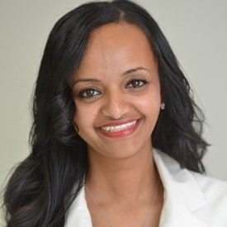
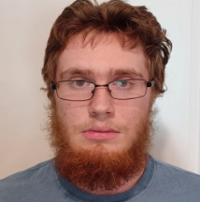
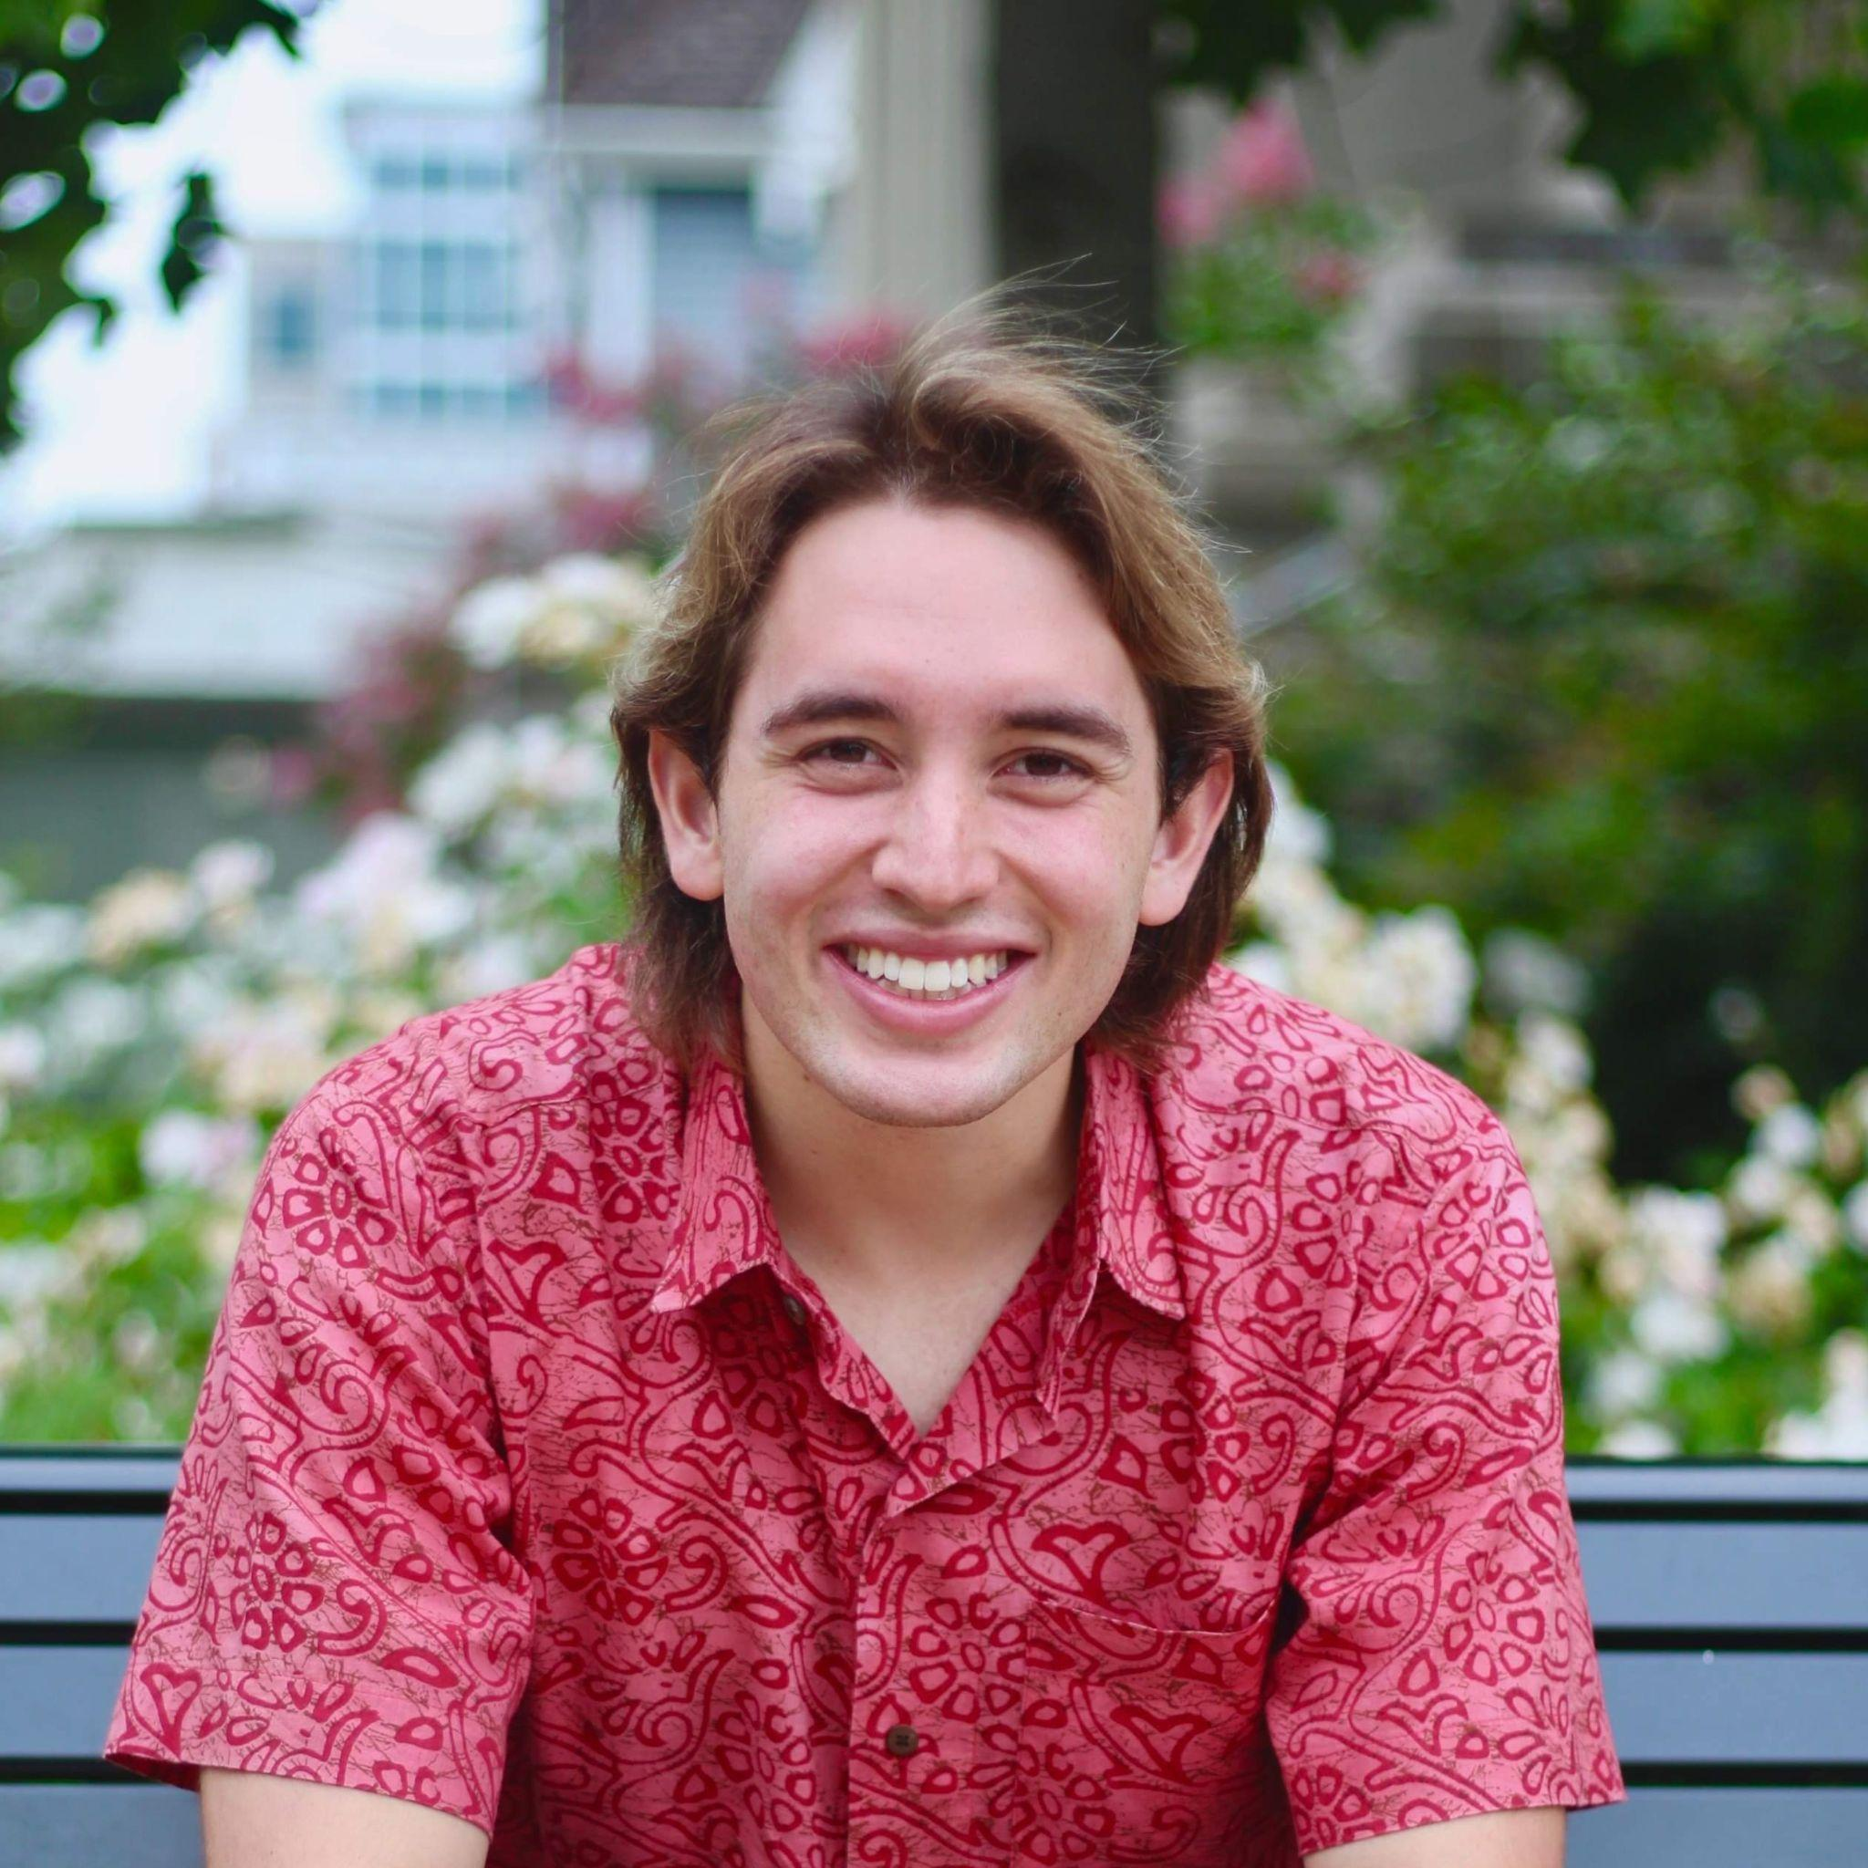
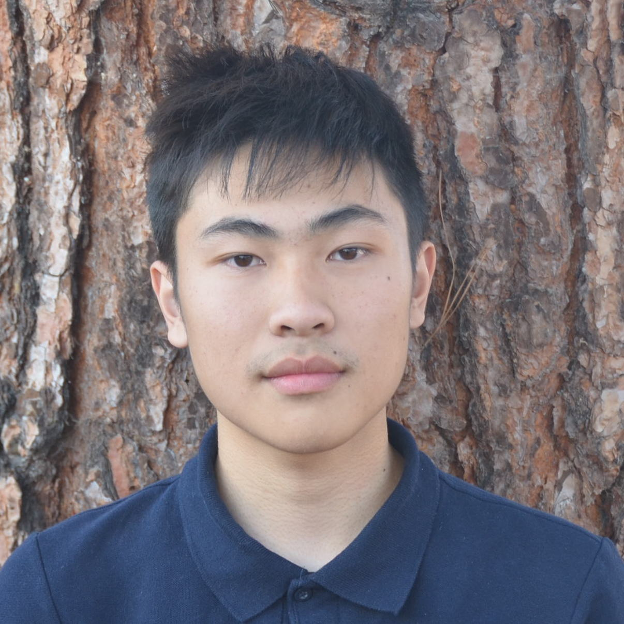
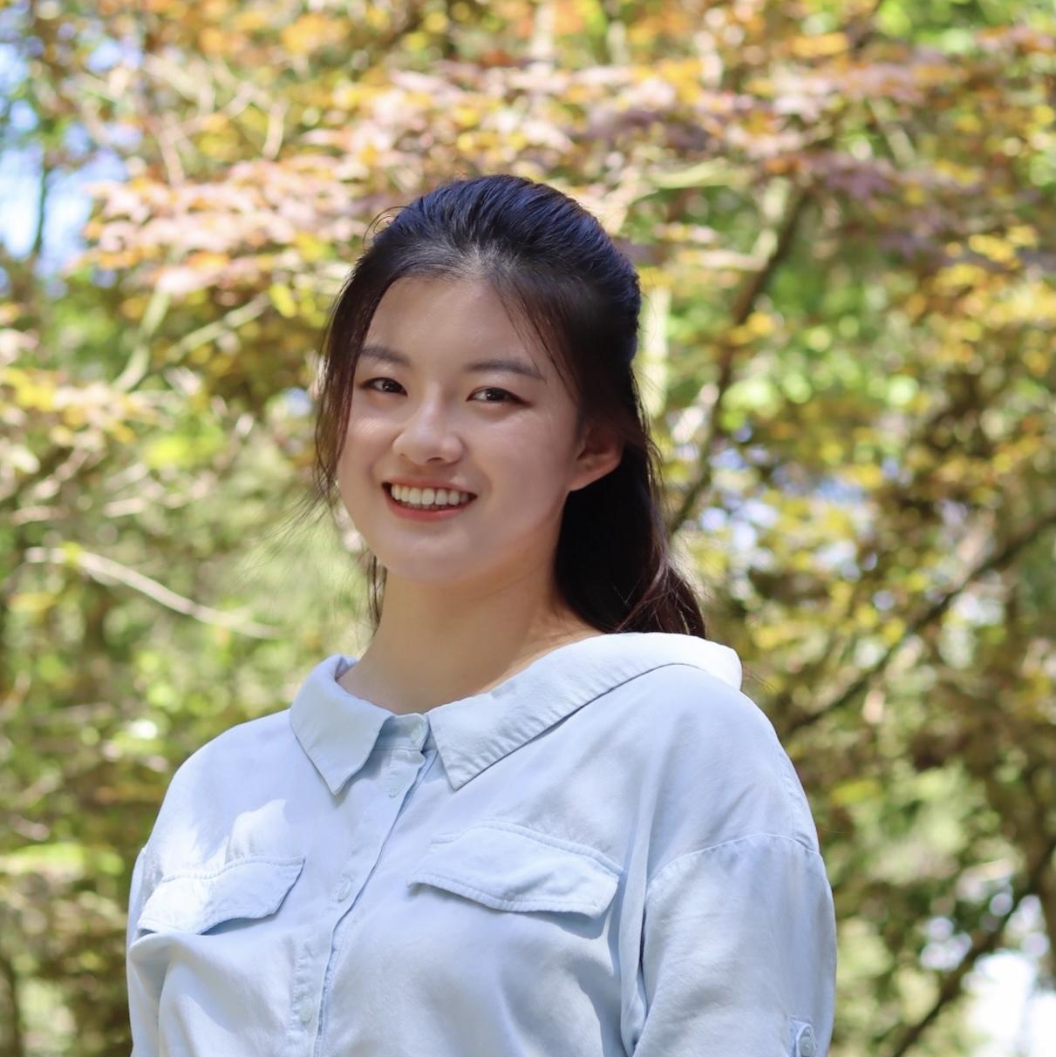
Introductions
William Wygal 24’
Econ+Math
David Chabra 24’
Math/Econ+Statistics
Tylor Wu 24’
BS, Math/Econ
MA, Economics
Shiyu Ma 23’
Math/Econ+Statistics

Slide 3
Challenge Statement
Not able to find an interesting research topic,
Couldn’t balance between school, work and research,
Tired with basic assistant work…
Many undergrads who are interested in research face challenges.
How does the UCLA Economics Undergrad Research Fellows Program bridge these gaps between students and research careers?
Source: https://www.cnbc.com/2023/04/06/layoffs-are-up-nearly-fivefold-so-far-this-year-with-tech-companies-leading-the-way.html

Slide 4
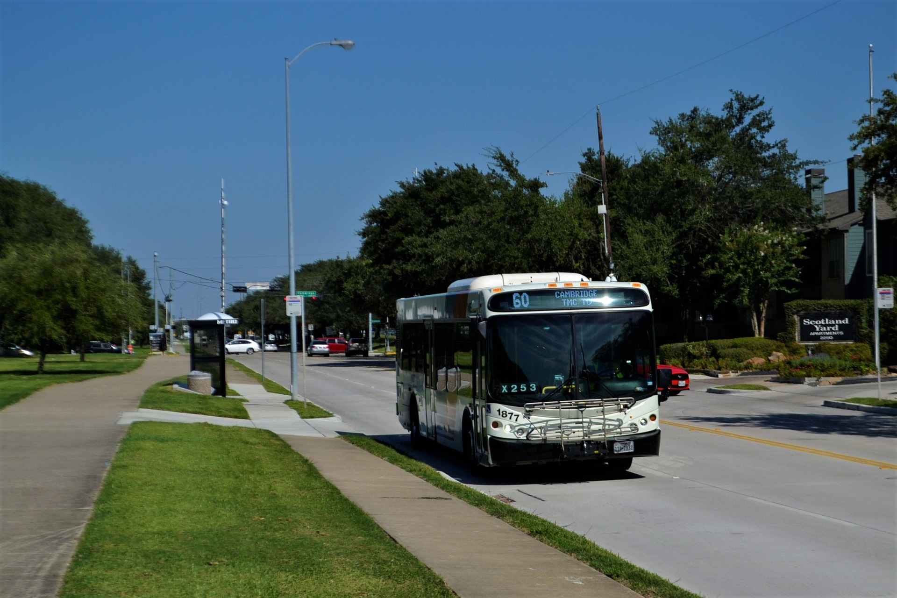
How I got interested in Economics
In highschool had a lack of direction
Met a financial writer on the bus
Got interested in economics

Slide 5
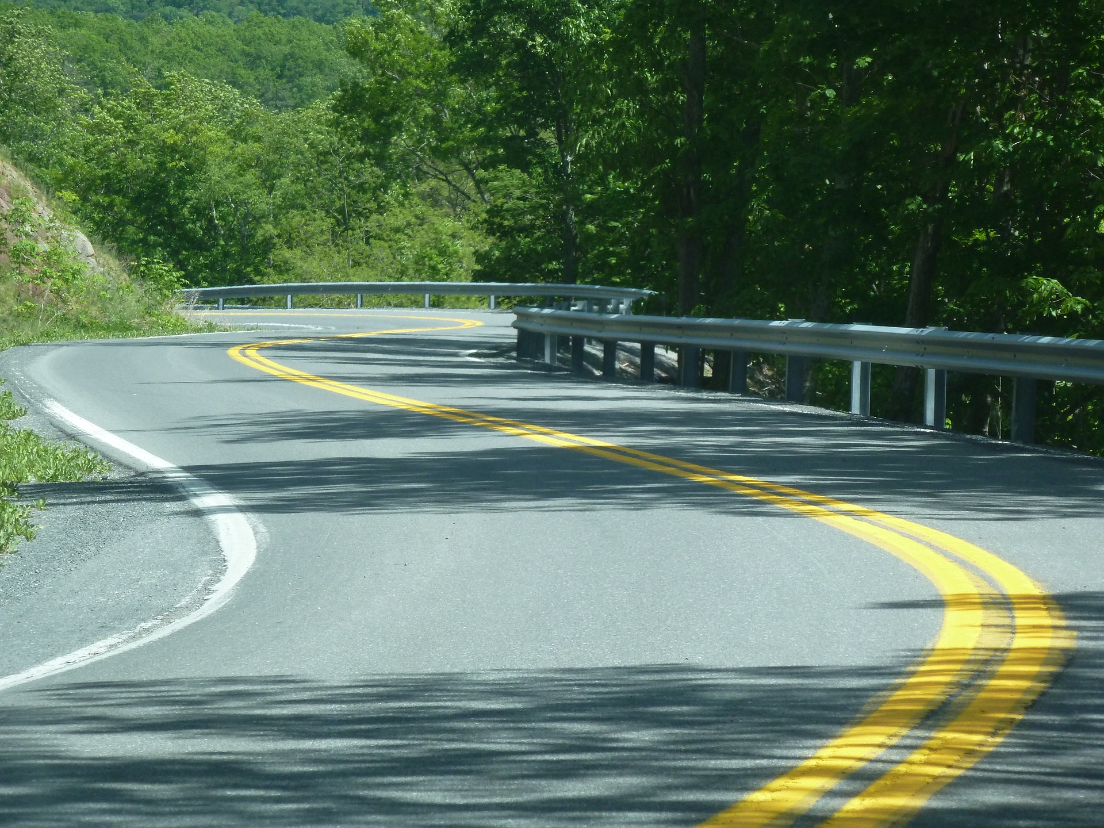
My Research Journey
Dabbled in high school
Entered college excited
Worked on several projects
Found it challenging to balance school and work with volunteer research
Got into Undergraduate Economics Research Fellows program

Slide 6
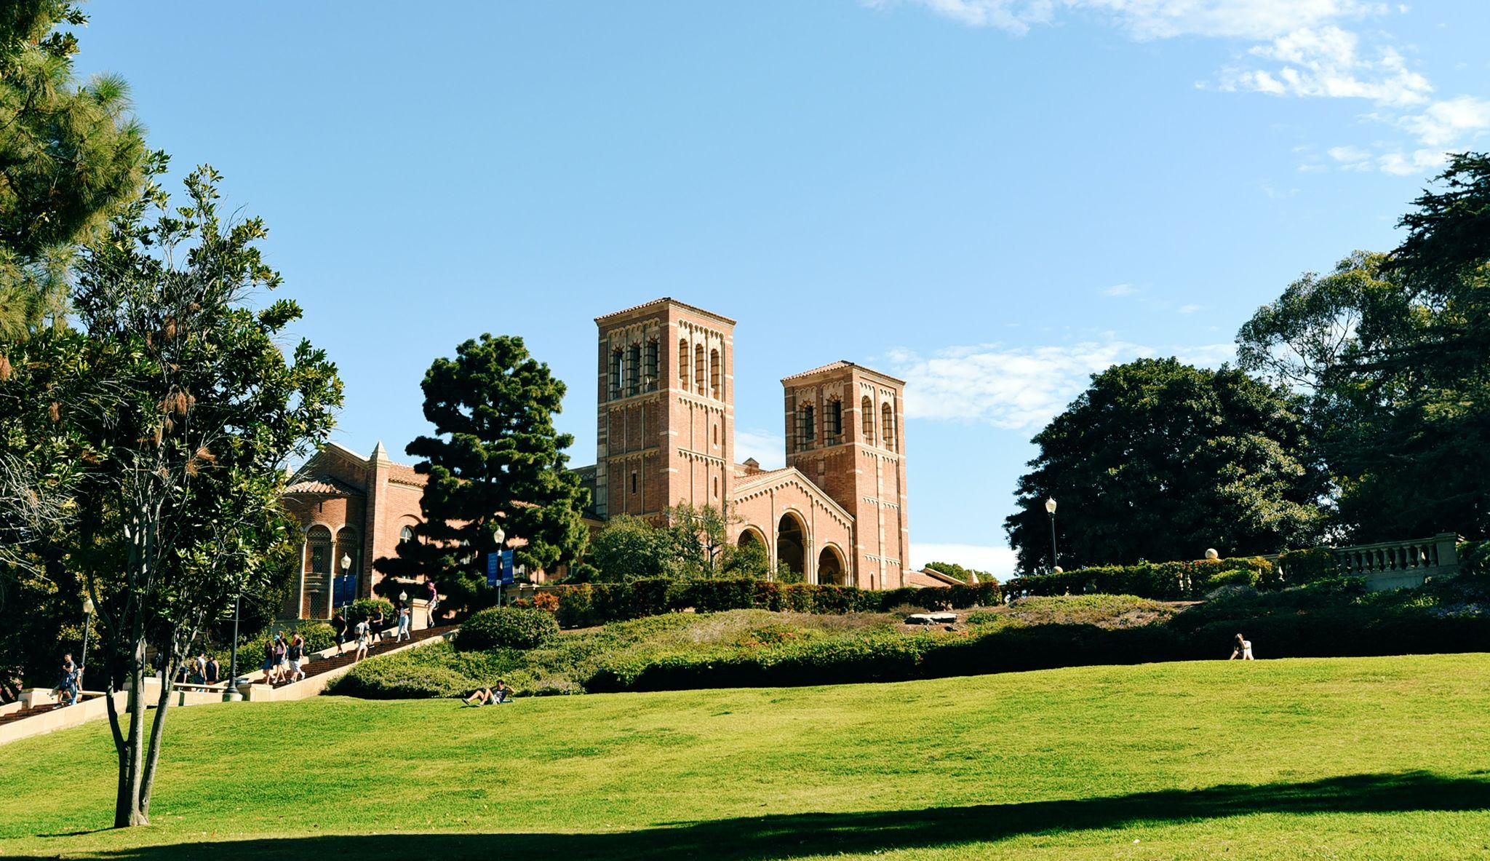
Your Impact
Allowed me to focus on research
Studying how low-wage workers are affected by layoffs
Studying the benefits of restorative justice

Slide 7
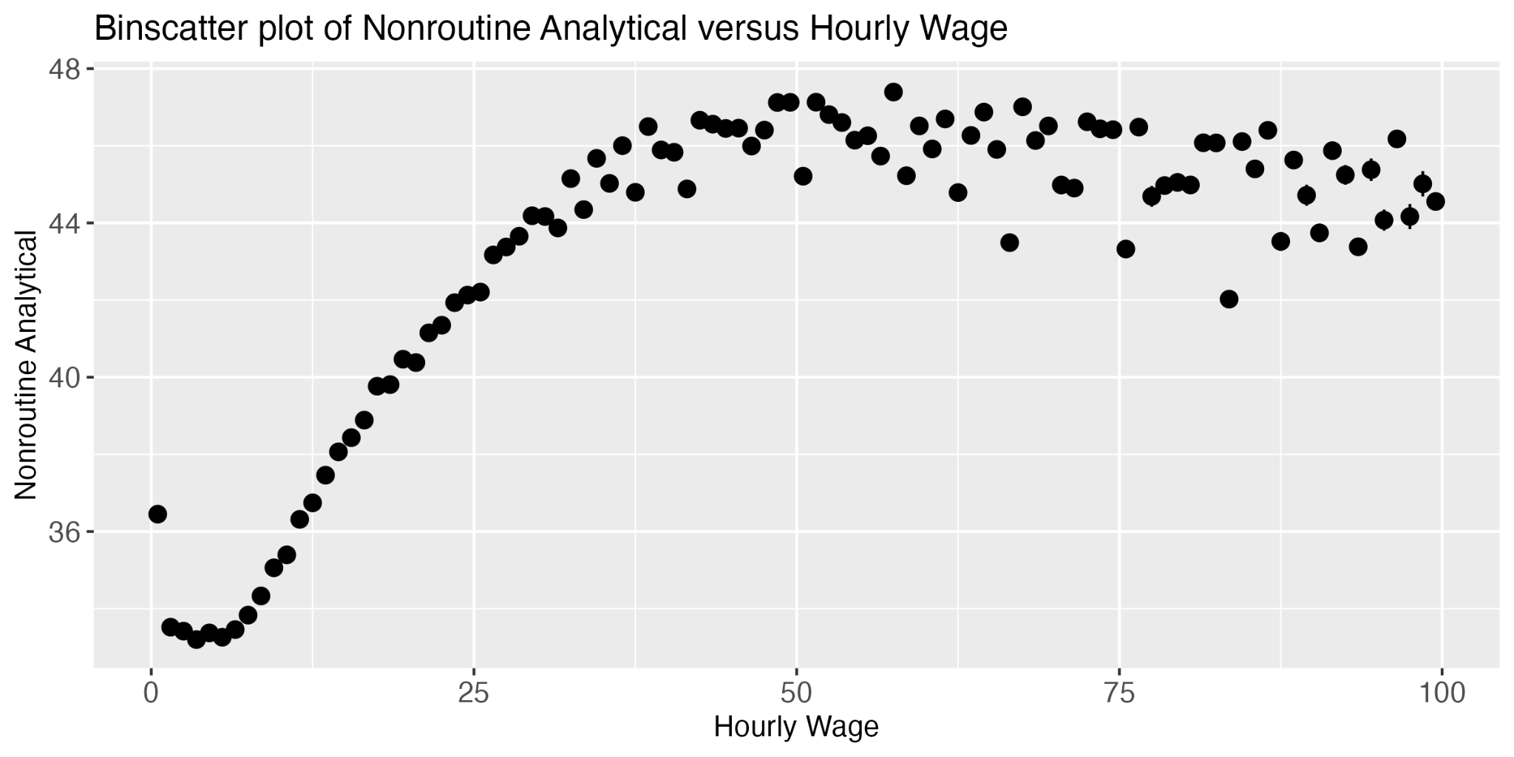
What makes a low-wage job?

Slide 8
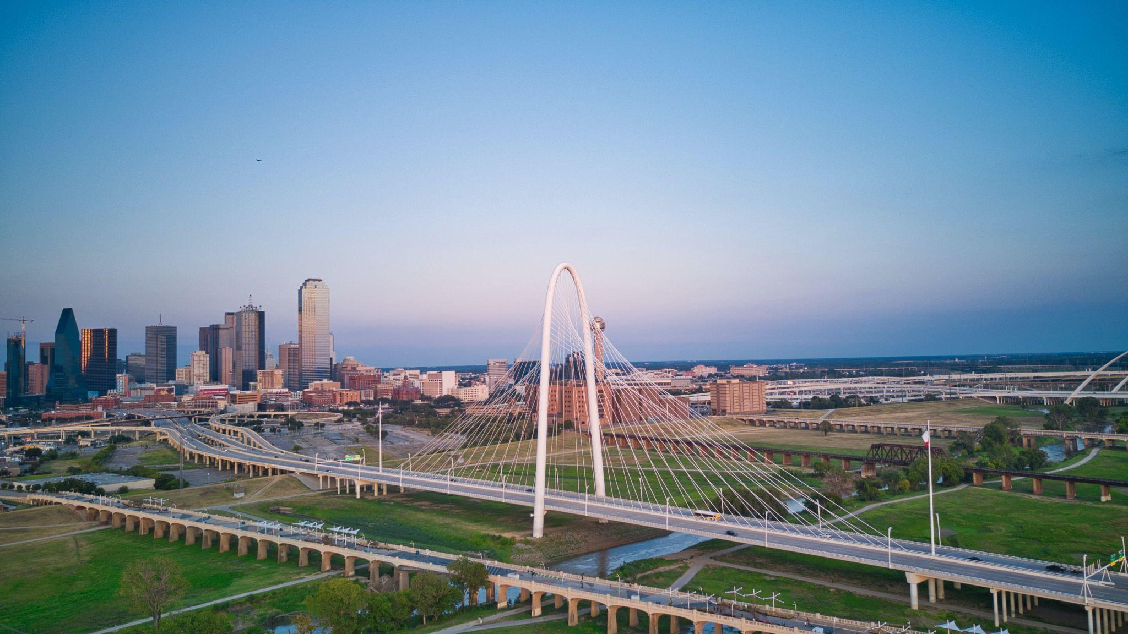
Going Forward
Working at the Dallas Federal Reserve this summer
Hoping to pursue graduate school in economics

Slide 9

Continuing Impacts
Utilizing skills in senior thesis project
Research intern at Federal Reserve Bank of New York
Applying for graduate school this fall

Slide 10
Before the Research Fellows Program
Interested in practical implications of economics research
Answering “What ifs”
Some research assistant work
Isolated parts of research process

Slide 11
Impact of the Fellows Program
Ability to explore different fields
Studied design of certification systems in markets
Exposure to more of research process
Open-ended problem solving experience

Slide 12
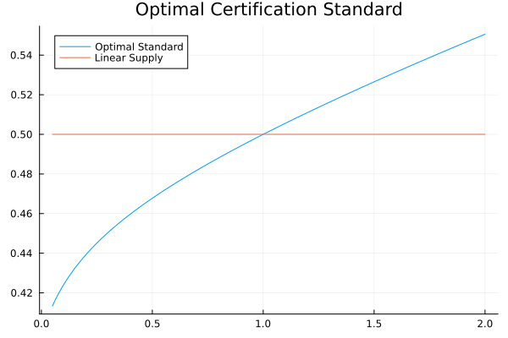
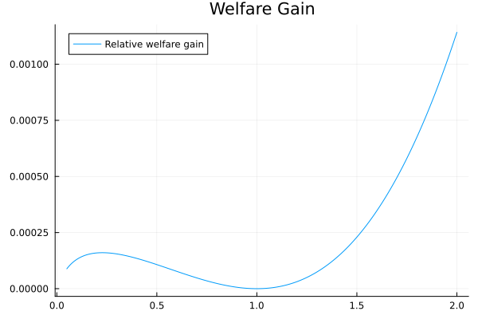
What is the optimal fraction of firms to certify?

Slide 13
Before the Research Fellows Program
Wanted to pursue a PhD
Was unsuccessful in obtaining research positions
Found it difficult to balance potential opportunities with other obligations

Slide 14
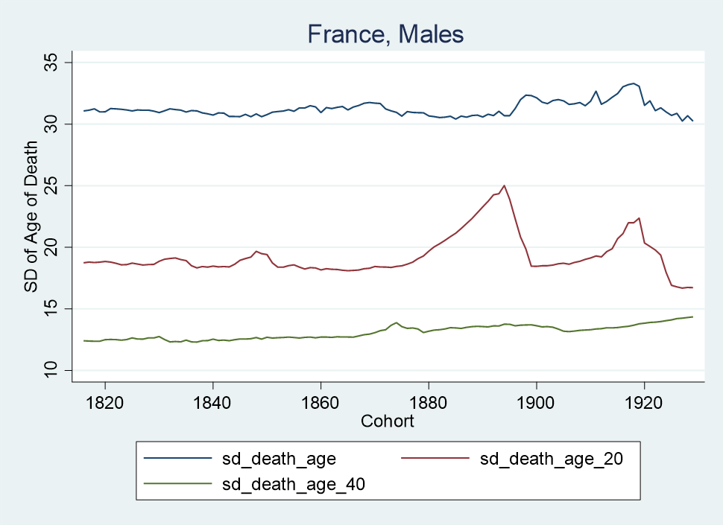
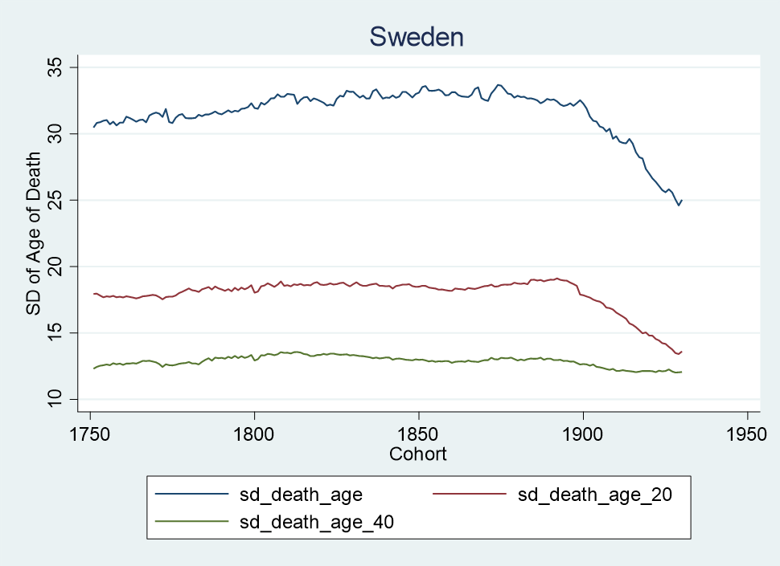

Slide 15
Effects of the Program
Going Forward
Opportunity to investigate disparities in longevity by SES
Address more sophisticated, nuanced, and original questions
Learn to confront obstacles that don’t arise in other contexts
I intend to start working on my own paper and applying to PhD programs in the fall

Slide 16

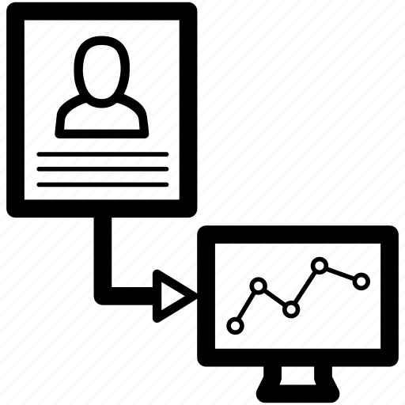
My Journey to the Fellows Program
Interested in subjective utility equation: Non-judgmental
Dived deep into different decision mechanisms: Behavioral data science
Changed perspective to microeconomics: Theories beyond available data

Slide 17
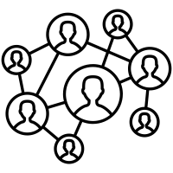
Information Diffusion in Social Network:
Optimal network density that maximizes social welfare?
Threshold that social learning crowds out individual experimentation?
To understand the diffusion of innovations which are key drivers of long-term economic growth

Slide 18
Impact of the Program and Beyond
Opportunity to jump out of my familiar research routine, ask new questions
More bargaining power in choosing research topic, ensured long-term commitment
Exposure to theoretical research work
Combined Economics and Statistics in Behavioral Data Science
Summer: Data Science Intern at Adobe
Fall: Harvard Master in Data Science

Slide 19

Conclusion
This program has bridged the gap for students to economics research
Focusing on Research
The Matched Topics
Open-ended Challenges

Slide 20
Thank You

